Slide 1
Algebra : 1. Functions
A set is a collection of well defined objects
A relation pairs up elements of set A with elements of set B
A relation ‘f’ which associates to each element of a set A to exactly one element of the set B is called a function from A to B and is denoted by
A -→ B
If ‘f’ A→B then A is called the Domain of ‘f’ and B is called the co-domain of ‘f’

Slide 2
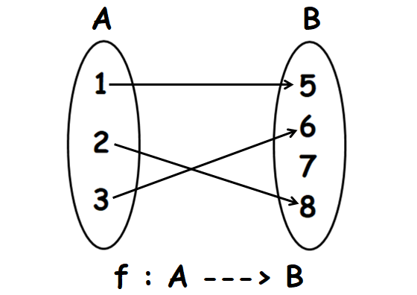
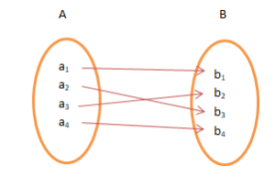
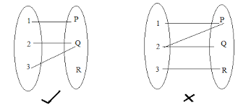
Types of functions

Slide 3

Functions
Note:
Range ≤ Co-domain
f ≤ A x B
Every element of A has a unique f-image in B
Two or more elements in A can have the same f-image in B
There may be elements in B which are not f-images of any element in A
There cannot be any element left in set A which is not mapped on to an element in the set B

Slide 4
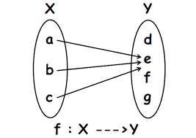
Functions
Constant function:
A function f: A→ B is said to be a constant function if f(x) = ‘e’ for all x belonging to A, where e’ is a fixed element of B .

Slide 5



Function
What is a function?
A function is just a “recipe” for turning any “input” number into another number, called the “output” number. The input number is usually called x, and the output number is f(x) or y. For instance, the function f(x) = 3x² + 2 is a three-step recipe for turning any input number, x, into another number, f(x), by the following steps: (1) square x, (2) multiply this result by 3, and (3) add 2 to this result. The final result is called f(x) or y.
If f(2x) = x + 2 for all values of x, which of the following equals f(x)?
A) B) C) D) 2x – 2

Slide 6
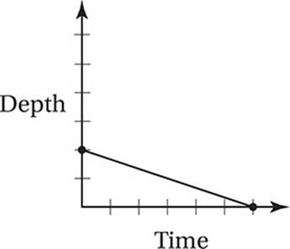
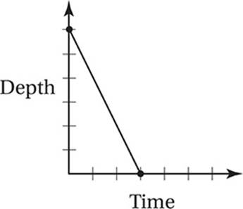
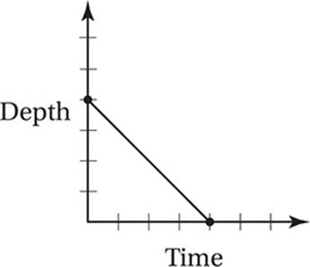
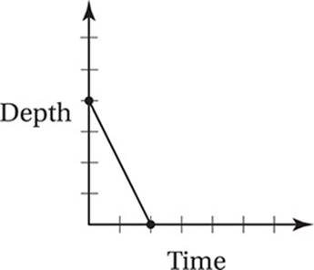
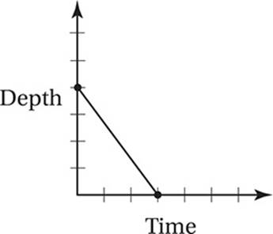
exercise
The graph shows the depth of water in a right cylindrical tank as a function of time as the tank drains. Which of the following represents the graph of the situation in which the tank starts with twice as much water as the original tank had, and the water drains at three times the original rate?

Slide 7
exercise
If f(x) = x² + 1 and g(f(x)) = 2x² + 4 for all values of x, which of the following expresses g(x)?
A) g(x) = 2x + 1
B) g(x) = 2x + 2
C) g(x) = 2x + 3
D) g(x) = 2x² + 1

Slide 8


EXERCISE
If and a and b are positive numbers, what is the value of

Slide 9
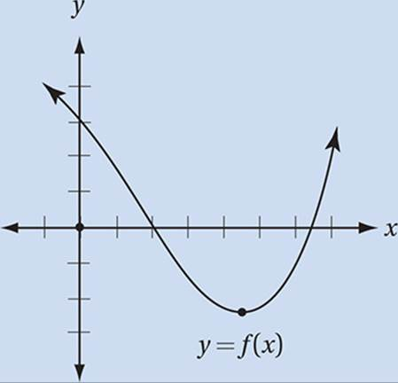
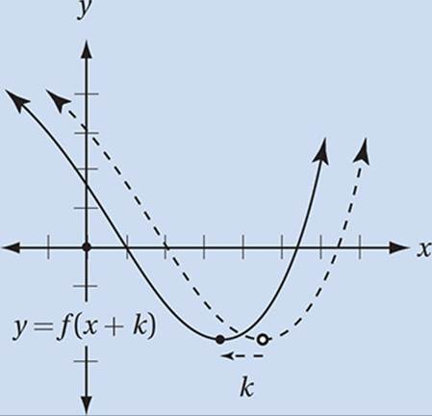
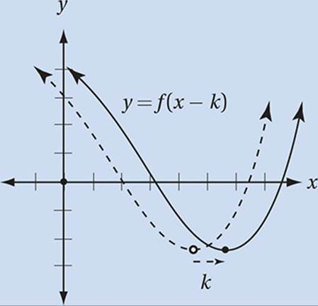
Function Transformations
If the function y = f(x) is graphed in the xy-plane (as in the example), then the following represent transformations of function f.
The graph of y = f(x + k), where k is a positive number, is the graph of y = f(x) shifted left k units.
The graph of y = f(x – k), where k is a positive number, is the graph of y = f(x) shifted right k units.

Slide 10
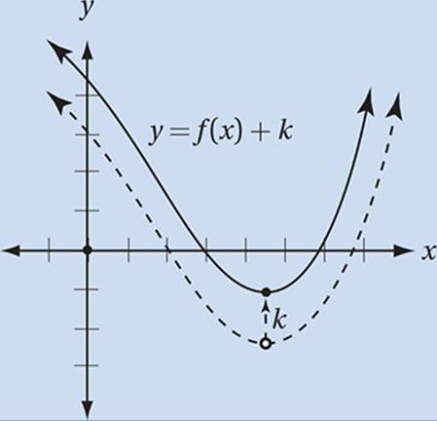
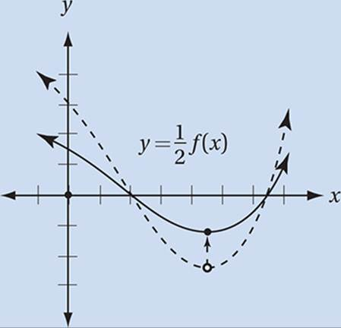
Function Transformations
The graph of y = f(x) + k, where k is a positive number, is the graph of y = f(x) shifted up k units.
The graph of y = kf(x) is the graph of y = f(x) stretched vertically by a factor of k (if k > 1) or shrunk vertically by a factor of k (if k < 1).

Slide 11
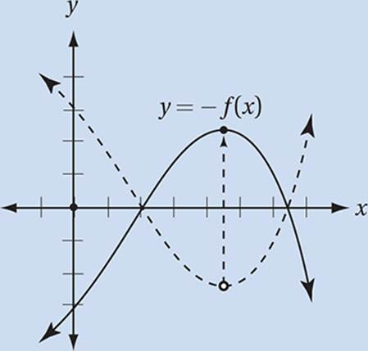
Function transformations
The graph of y = –f(x) is the graph of y = f(x) reflected over the x-axis.

Slide 12

Functions Exercise
1). If f(x) = ( x – 1.5) ( x – 2.5)( x – 3.5) ( x – 4.5) then for what value of x is f(x) < 0
A) 1 B) 2 C) 3 D) 4.5 E) 5.5

Slide 13
solution
f(1) = ( 1-1.5) (1-2.5) (1-3.5) (1-4.5)
= < 0 < 0 < 0 < 0 --→ > 0
f(2) = (2-1.5) (2-2.5) (2-3.5) (2-4.5)
= > 0 < 0 < 0 < 0 ---→ < 0
So the answer is ‘B’

Slide 14
Functions
f(3,4) = ( 2x3 + 4 ) = 10
A) f(3,7) = (2x3 + 7) = 13
B) f(3,10) = (2x3 + 10) = 16
C) f(4,3) = ( 2x4 + 3) = 11
D) g(3,4) = ( 3 + 2x4) = 11
E) g(4,3) = ( 4 + 2x3) = 10
So the answer is ‘E’
Exercise:
2). If ( x, y ) = 2x + y and g( x, y) = x + 2y then find f( 3, 4)
A) f( 3,7)
B) f( 3, 10)
C) f(4,3)
D) g( 3, 4)
E) g( 4, 3)

Slide 15
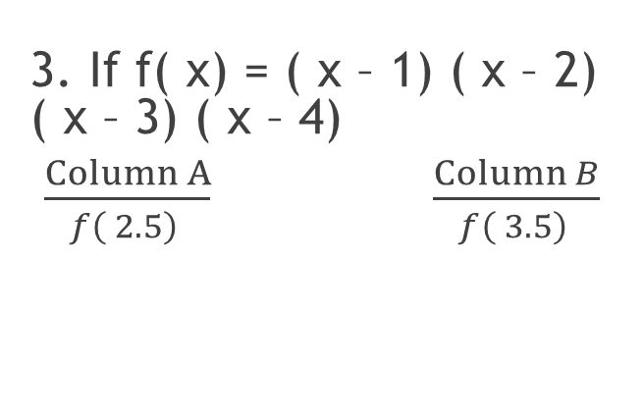
Functions : Exercise
f(2.5) = (2.5-1) (2.5-2) (2.5-3) (2.5-4)
= > 0 > 0 < 0 < 0
--→ > 0, positive
f(3.5) = (3.5-1) (3.5-2) (3.5-3) (3.5-4)
= > 0 > 0 > 0 < 0
--→ < 0 , negative
so column A > column B
The answer is ‘A’
3. If f( x) = ( x – 1) ( x – 2) ( x – 3) ( x – 4)
$\frac{Column A}{f\left( 2.5\right) } \frac{\operatorname{Column}{B}}{f\left( 3.5\right) }$

Slide 16

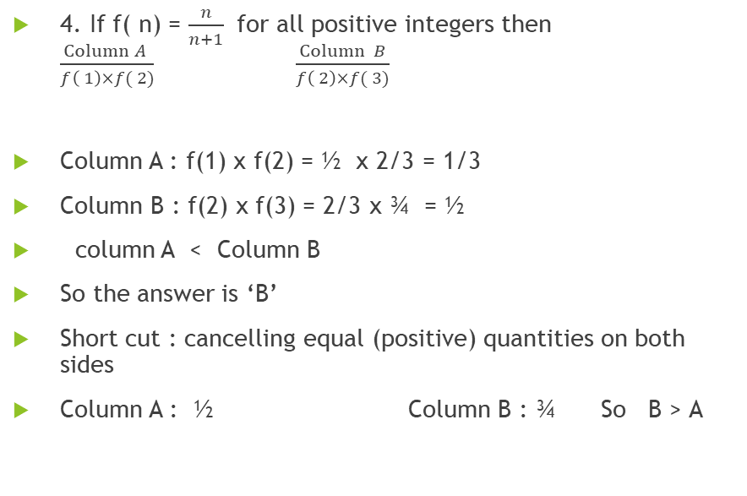
Functions : Exercise
4. If f( n) = $\frac{n}{n+1}$ for all positive integers then $\frac{\operatorname{Column}{A }}{f\left( 1\right)×f( 2)} \frac{\operatorname{Column}{B}}{f\left( 2\right)×f( 3)}$
Column A : f(1) x f(2) = ½ x 2/3 = 1/3
Column B : f(2) x f(3) = 2/3 x ¾ = ½
column A < Column B
So the answer is ‘B’
Short cut : cancelling equal (positive) quantities on both sides
Column A : ½ Column B : ¾ So B > A

Slide 17

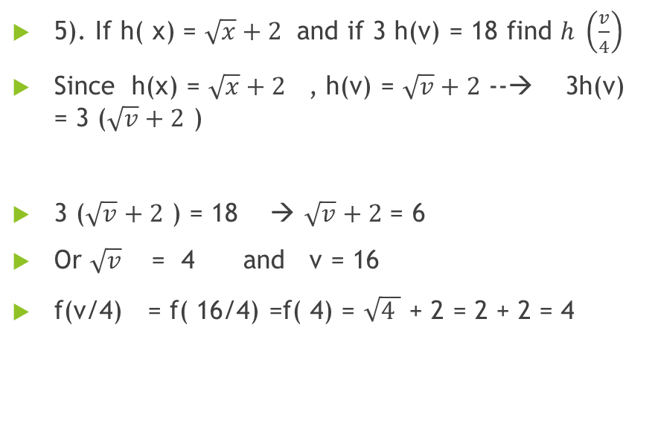
Exercise
5). If h( x) = $\sqrt{x}+2$ and if 3 h(v) = 18 find $h \left(\frac{v}{4}\right)$
Since h(x) = $\sqrt{x}+2$ , h(v) = $\sqrt{v}+2$ --→ 3h(v) = 3 ($\sqrt{v}+2$ )
3 ($\sqrt{v}+2$ ) = 18 → $\sqrt{v}+2$ = 6
Or $\sqrt{v}$= 4 and v = 16
f(v/4) = f( 16/4) =f( 4) = $\sqrt{4 }$ + 2 = 2 + 2 = 4

Slide 18
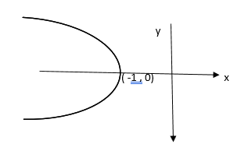
Functions: Exercise
6.
The graph is a parabola that is symmetric about the x – axis . which of the following could be the equation of the parabola?
a) x = -y² – 1
b) x = - y² + 1
x = - y²
x = y² - 1
e) x = ( y + 1)²

Slide 19
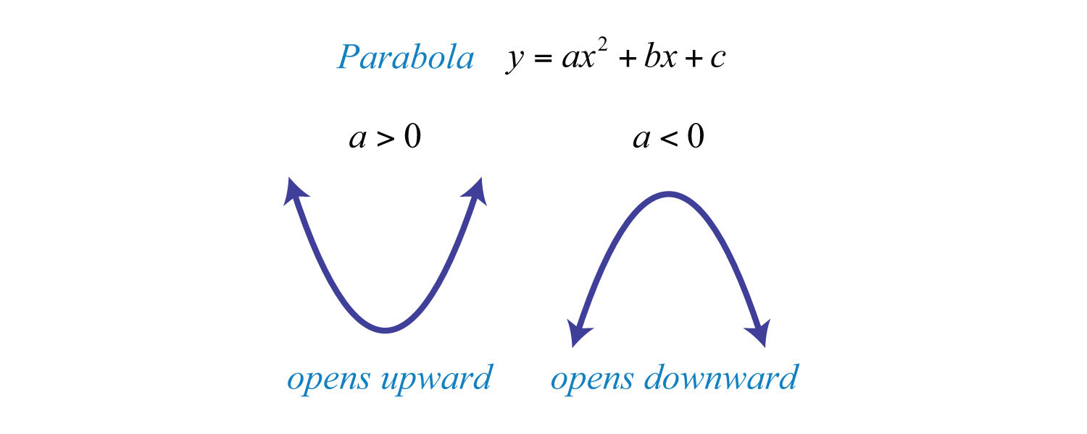
Parabola y = ax² + bx + c is the equation of a parabola that is symmetric about the y-axis. If the co efficient of x² is positive then the parabola will move upwards and if the co efficient of x² is negative then the parabola will move downwards.

Slide 20
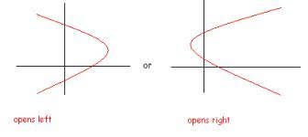
Exercise
x = ay2 + by + c is the equation of a parabola that is symmetric about
the x-axis. If the co efficient of y2 is positive then the graph will turn
to the right and if the coefficient of y2 is negative then the graph will
turn to the left.
In the given fig the parabola is turned left. Therefore the
Co efficient of y2 must be negative.
Substituting ( -1,0) in the given set of equations
we find the answer is ‘A’

Slide 21


Functions
7. g(x) = ${\left(2x−3\right)}^{\frac{1}{4}}+1$
In the function above, for what values of x is g(x) a real number?
A) X $≥$ 0 B ) x $≥$ ½ C) x $≥$ 3/2 D) x $≥$2 E) x $≥$ 5/2
Checking for real number :
No negative value under root
No division by zero
--→ 2x – 3 $≥$ 0
2x $≥$ 3 or x $≥$ 3/2

Slide 22

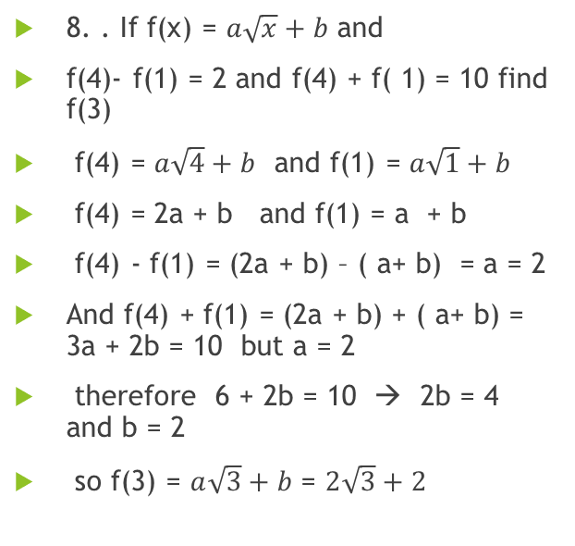
Functions
8. . If f(x) = $a\sqrt{x}+b$ and
f(4)- f(1) = 2 and f(4) + f( 1) = 10 find f(3)
f(4) = $a\sqrt{4}+b$ and f(1) = $a\sqrt{1}+b$
f(4) = 2a + b and f(1) = a + b
f(4) - f(1) = (2a + b) – ( a+ b) = a = 2
And f(4) + f(1) = (2a + b) + ( a+ b) = 3a + 2b = 10 but a = 2
therefore 6 + 2b = 10 → 2b = 4 and b = 2
so f(3) = $a\sqrt{3}+b$ = $2\sqrt{3}+2$

Slide 23
Functions : Exercise
9. . At time t = 0, a Projectile was fired upward from an initial height of 10 feet. If the height reached after t secs is given by the function h(t) = p – 10 ( q – t)² where p and q are positive constant. If the projectile reached a maximum height of 100 feet when t = 3, then what is the height in feet of the projectile when t = 4?
Initial height h = 10 ft at time t = 0
h(t) = p – 10 ( q – t)²
h (0) = p – 10 ( q – 0)² = 10
-→ p – 10q² = 10 eqn 1
At t =3 , h = 100
h(3) = p – 10 ( q – 3)² = 100
Expanding (p – 10q² )+60q-90 = 100
From eqn 1
=> 10 +60q - 90 = 100 or q = 3
Sub in 1, p = 100
Therefore h(4) = 100 -10(3-4)²
= 90 feet.

Slide 24
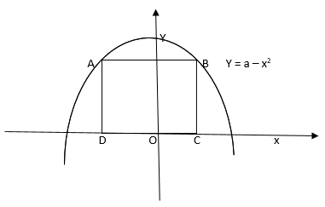
Functions
10.
The figure above shows the graphs of y = a – x² for some positive constant ‘a’. if the square ABCD intersects the graph at points A and B and if the area of square is 16. What is the value of ‘a’?

Slide 25
Solution
The equation of the parabola is
y = a- x2 .
The square intersects the parabola at points A and B .
The area of square is 16, which means the side of square is = 4
The graph is symmetric about the y axis
Therefore the co ordinates of A and B are
( -2,4) and (2,4) respectively.
Since these points are on the parabola they must satisfy the equation.

Slide 26
Functions
11. If f(x) = 2x and g(x) = x³ what is the value of f(g(-3))
g(-3) = (-3)³ = -27
f (-27) = -54

Slide 27
Exercise
. If f(x) = (x – 3) and 2[f(g)] = 14 what is the value of f(4g)?
2[f(g)] = 14 => [f(g)] = 7
(g-3) = 7 and g = 10
f(4g) = f(40) = 40 – 3 = 37

Slide 28
example
If f(a, b) = a²b⁴ and f(m,n) = 5 then what is f(3m, 2n)
Required is the value of f(3m, 2n)
If f(a, b) = a²b⁴
then f(3m, 2n) = (3m)²(2n)⁴ = 9m² x 16n⁴
= 144m² n⁴
^{But} f(m,n) = 5 ➔ m² n⁴ = 5
→ f(3m, 2n) = 144 x 5 = 720

Slide 29
Functions
g(x) = x² – 3 and g(m) = 61
-→ g(m) = m² – 3 = 61
m² = 64 and m = 8 as m > 0
h(m) = 2m – 1 = 2(8) – 1 = 15
If h( x) = 2x – 1 and g(x) = x² – 3 if g(m) = 61, what is h(m) ,
if m > 0 ?

Slide 30
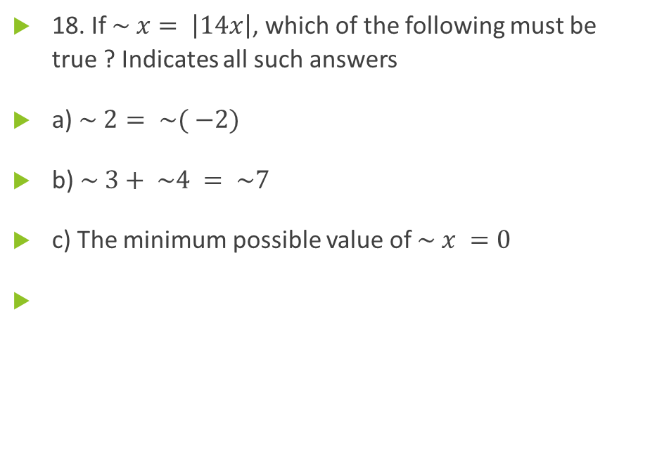
Functions
18. If $\sim x= \left|14x\right|$, which of the following must be true ? Indicates all such answers
a) $\sim 2= \sim ( −2)$
b)$\sim 3+ \sim 4 = \sim 7$
c) The minimum possible value of $\sim x =0$

Slide 31
Functions
If # x = the square of the number that is 2 less than x. What is the value of #5 - # ( -1)

Slide 32
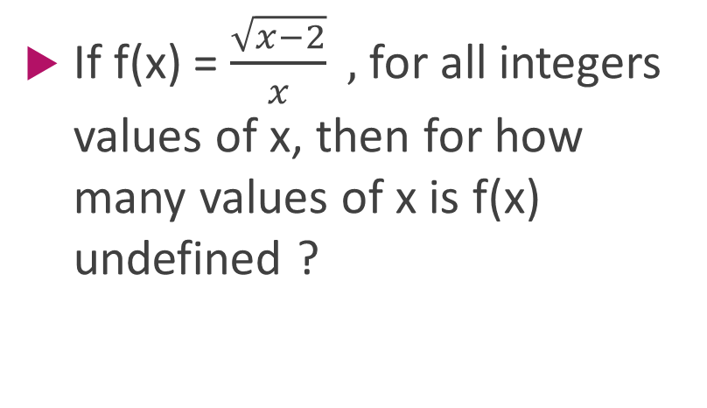
Functions
Exercise
If f(x) = $\frac{\sqrt{x−2}}{x} ,$ for all integers values of x, then for how many values of x is f(x) undefined ?

Slide 33
Functions
If f(2a) = 2f(a) and f(6) = 11 find the value of f( 24)

Slide 34
Functions
The maximum height reached by a ball thrown straight up into the air can be determined by the formula h = - 16t² + vt + d, where t is the time in secs sink it was throw, V is the initial speed of throw 1m feet per sec, d is the height from which the ball is released , and ‘h’ is the height of the ball, t secs after the throw. Two secs after the ball is thrown, how high is the ball if it was released at a height of 6 feet and a speed of 80 feet per second

Slide 35

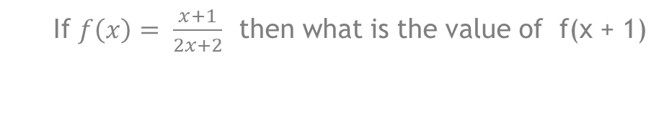
Functions
If $f\left(x\right)= \frac{x+1}{2x+2}$ then what is the value of f(x + 1)

Slide 36
Functions
. If f(x) = 2x + 2, g(x) = 3x + 3; h(x) = 4x + 4 find f[g(h(x))]

